Slide 1




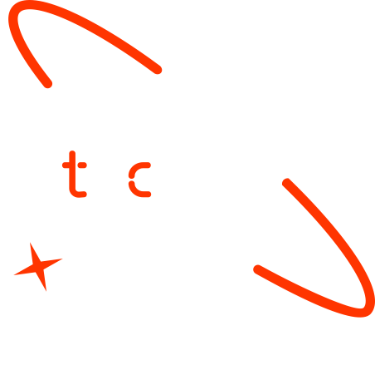

A new generation
of tech specialists

Slide 2
Student performance on exams.
Mahsa Hamidi, Noorullah Zamindar, Ahmad Reshad Amir beag, Abdulrawof Totakhil, Eshaq Karimi, Yaser Zarifi

Slide 3
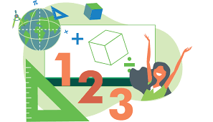
Background
Education plays a crucial role in shaping an individual’s future, and mathematics is a fundamental subject that serves as a foundation for many fields. However, disparities in math performance among students from different backgrounds can limit their educational and career opportunities. By understanding the factors that impact students' math performance, educators and policymakers can develop targeted interventions to improve educational outcomes. Identifying these key determinants will help create more equitable learning environments and support students in reaching their full potential. Our capstone project aims to predict students' math scores using various features. By leveraging supervised machine learning techniques, we seek to uncover the key factors that influence math performance.

Slide 4
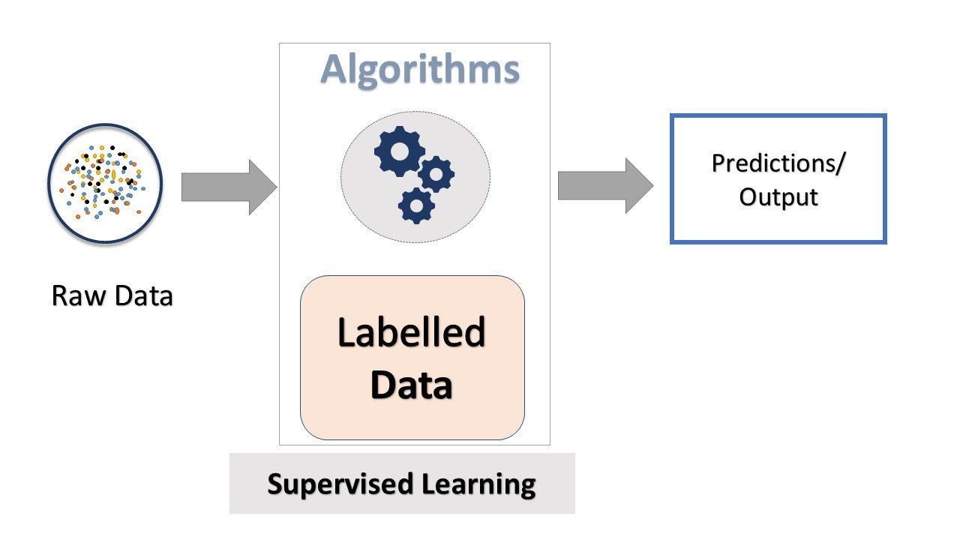
Objectives
The primary objective of this project is to predict students' math scores by analyzing various factors, such as gender and parental education level. By doing so, we aim to identify the key influences on students' math performance.To achieve this, we will use supervised machine learning techniques, including Linear Regression and K-neighbors Regressor, to develop an efficient and accurate predictive model. Our goal is to provide valuable insights to educators and policymakers, enabling them to create targeted interventions that enhance educational outcomes and promote equity in student performance.

Slide 5

SDG Relation
This project aligns with Sustainable Development Goal 4 (SDG 4): Quality Education. By understanding the factors that influence students' math performance, we can develop targeted interventions to enhance educational outcomes. This effort contributes to ensuring inclusive and equitable quality education and promotes lifelong learning opportunities for everyone.

Slide 6

Data

Slide 7
Data
Collected data was cleaned to ensure accuracy and reliability.
Features such as gender, parental education level, race, lunch type, test preparation course, writing scores, and reading scores were standardized to maintain consistency.
Collected data was cleaned to ensure accuracy and reliability.
Features such as gender, parental education level, race, lunch type, test preparation course, writing scores, and reading scores were standardized to maintain consistency.
The dataset, titled "Student Performance in Exams“, consists of the following features: gender, parental level of education, race, lunch type, test preparation course, math score, writing score, and reading score. The data is in CSV format and can be accessed from Kaggle.
Data Preprocessing involves cleaning and transforming raw data into a format that is suitable for building and training:
Collected data was cleaned to ensure accuracy and reliability.
Features such as writing scores and reading scores were standardized to maintain consistency.
Missing values were addressed using techniques such as mean/median imputation for numeric data and mode imputation for categorical data.
Outliers were identified and handled through methods such as capping, flooring, or removal to prevent skewing the results.

Slide 8
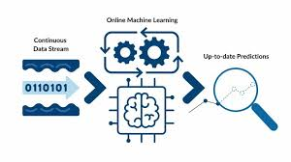
Model

Slide 9
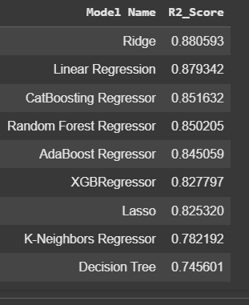
Model Selection and Training/Testing
We utilized supervised machine learning models such as Linear Regression, Lasso, Ridge, K-Neighbors Regressor, Decision Tree, Random Forest Regressor, XGBoost Regressor, CatBoost Regressor, and AdaBoost Regressor. The dataset was split into training and test sets to evaluate model performance.
Hyperparameters were tuned using grid search and random search techniques to identify the best model configuration. Cross-validation (CV) was employed to ensure that the models generalize well to unseen data. Each model was evaluated based on key metrics: Mean Absolute Error (MAE), Root Mean Squared Error (RMSE), and R2 Score.

Slide 10

Result

Slide 11
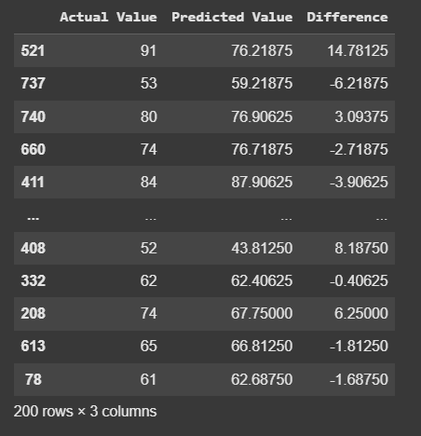
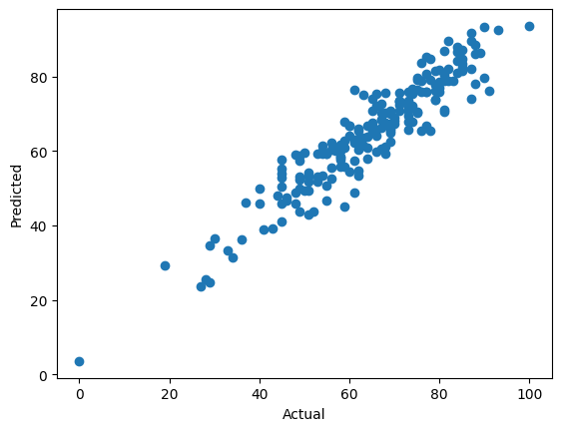
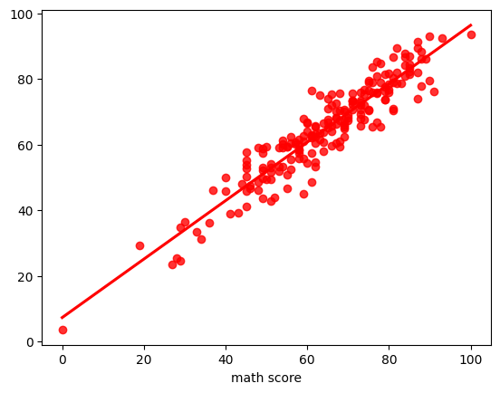
Evaluation Results
lin_model = LinearRegression(fit_intercept=True)
lin_model = lin_model.fit(X_train, y_train)
y_pred = lin_model.predict(X_test)
score = r2_score(y_test, y_pred)*100
plt.scatter(y_test,y_pred);
plt.xlabel('Actual');
plt.ylabel('Predicted');
sns.regplot(x=y_test,y=y_pred,ci=None,color ='red');
pred_df=pd.DataFrame({'Actual Value':y_test,'Predicted Value':y_pred,'Difference':y_test-y_pred})
pred_df

Slide 12

Deployment

Slide 13
Deployment
The trained machine learning models are serialized using libraries such as joblib or pickle to save them for later use. This enables us to efficiently store and load the models without retraining them each time.
The serialized models are served using a web framework such as Flask or FastAPI. This ensures that the models can be accessed through a RESTful API, allowing for real-time predictions.
The models are deployed on a cloud platform (e.g., AWS, Azure, or Google Cloud) to ensure scalability and accessibility.
API Integration:
An API is designed to facilitate communication between the model and the user-facing application.
The API endpoints handle requests for predictions by receiving input data, passing it to the model, and returning the predicted math scores.
Additionally, the API includes error handling and logging mechanisms to ensure reliability and monitor performance.

Slide 14
Conclusion and Futurework
Our project successfully developed a predictive model to forecast students' math scores by using various factors, including gender, parental education level, race, lunch type, participation in test preparation courses, writing scores, and reading scores. By applying supervised machine learning techniques, we identified key factors that influence math performance. These insights are valuable for educators and policymakers, as they can help create targeted interventions aimed at improving educational outcomes and promoting equity.
In our future work, we plan to enhance the accuracy of our model by exploring advanced techniques, such as deep learning and ensemble methods. We also aim to broaden our feature set to include attendance records, socio-economic status, and extracurricular activities. Additionally, we will develop a user-friendly application for real-time predictions and feedback. Finally, we intend to apply our model across various regions and educational systems to compare and contrast the factors affecting math performance, ensuring that our insights are widely applicable.

Slide 15


Thank you!

